Slide 1
Homework 2
COSE331 Computer Graphics

Slide 2
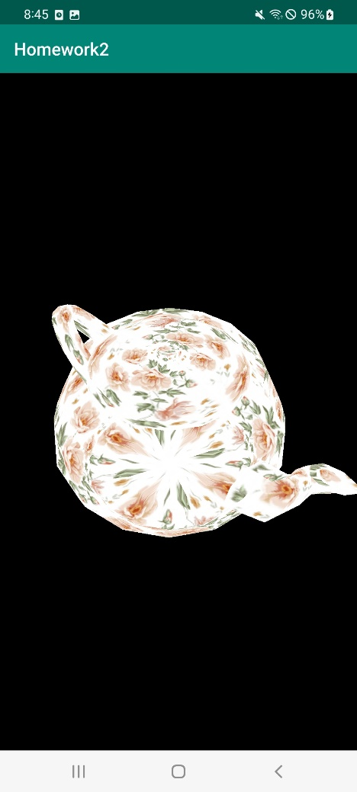
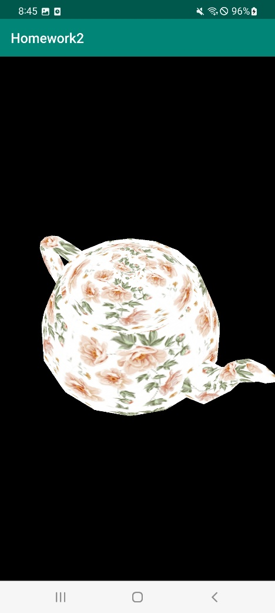
Problem 1
Z-버퍼링을 구현한다.
깊이 테스트를 활성화한다.

Slide 3
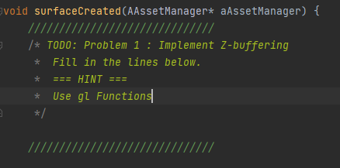
Problem 1
Enable depth testing to implement Z-buffering.
app/src/main/cpp/main.cpp

Slide 4
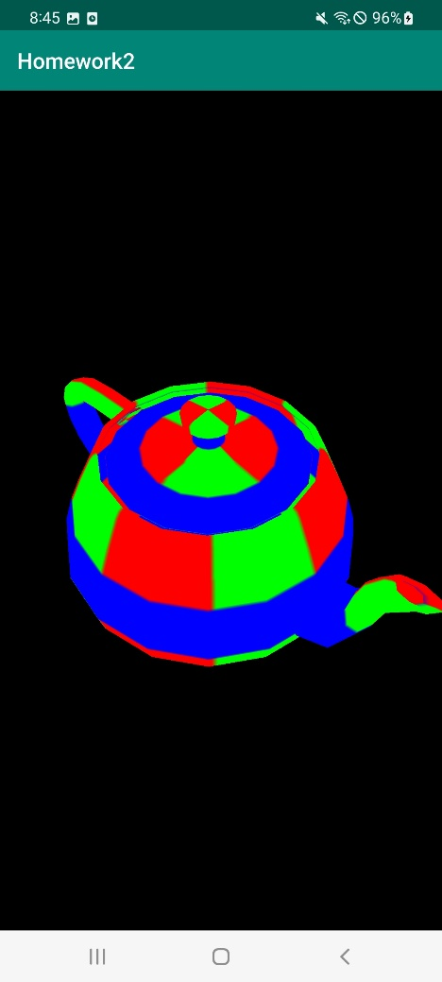
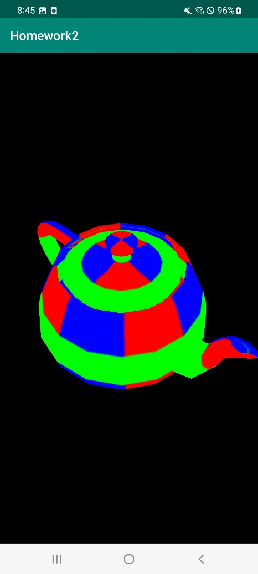
Problem 2
주전자의 텍스처를 RGB 텍스처로 변경한다.
RGB 텍스처의 색을 변경한다(빨간색→파란색, 파란색→초록색, 초록색→빨간색)

Slide 5
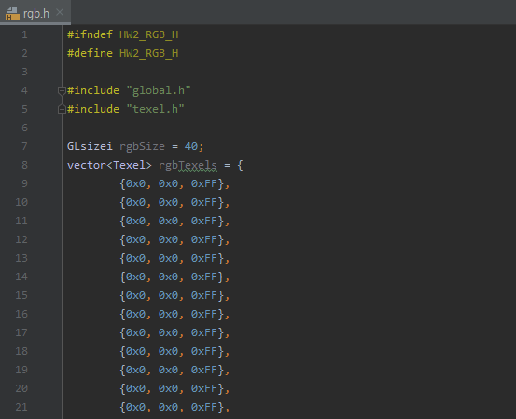
Problem 2
You can find the implementation of RGB texture in rgb.h file.
app/src/main/cpp/inc/binary/rgb.h
This header file is already included in scene.cpp

Slide 6
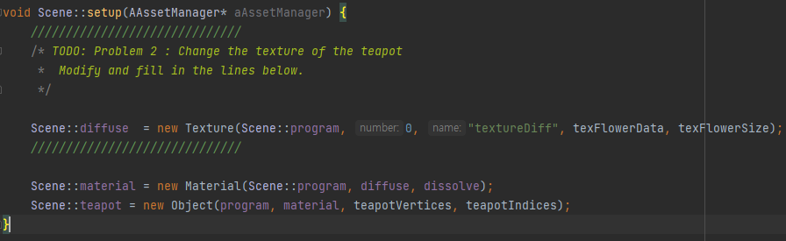
Problem 2
Modify and fill in some lines in Scene::setup(…).
app/src/main/cpp/scene.cpp

Slide 7

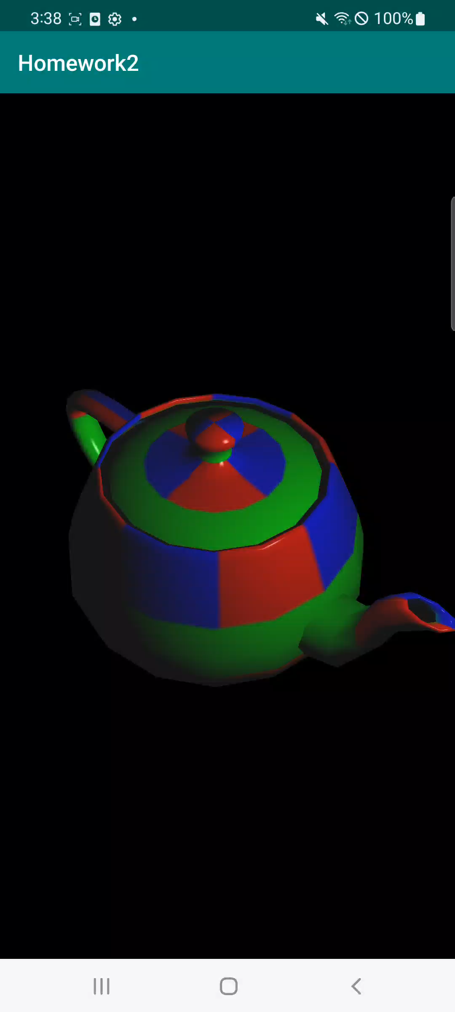
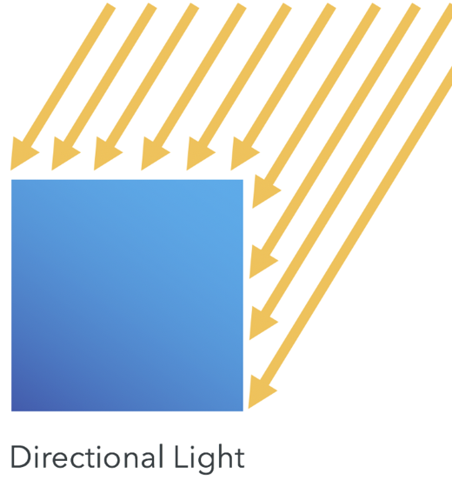
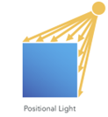
Problem 3
점 광원를 이용한 Phong lighting을 구현한다.
화면을 드래그할 때, 아크 볼 위에서 움직이는 점 광원을 구현한다.

Slide 8
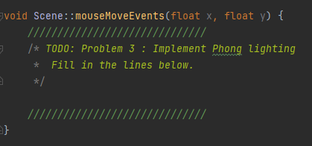
Problem 3
Modify and fill in some lines in Scene::mouseMoveEvents(…).
app/src/main/cpp/scene.cpp
Arc ball movement

Slide 9
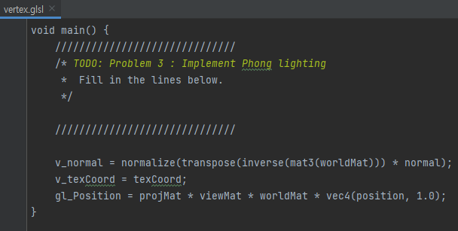
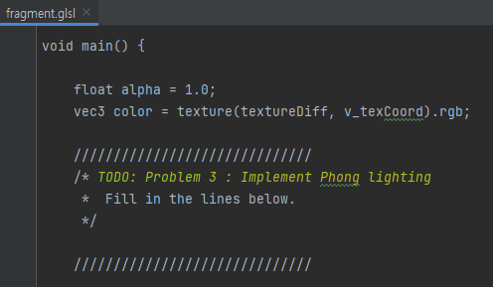
Problem 3
Fill in some lines in the vertex and fragment shader.
app/src/main/assets/vertex.glsl
app/src/main/assets/fragment.glsl

Slide 10
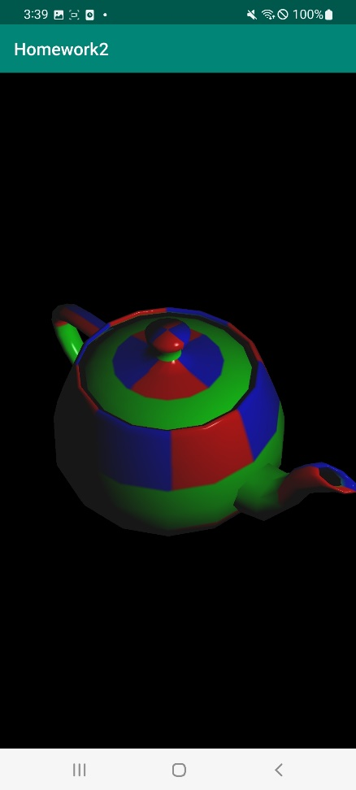
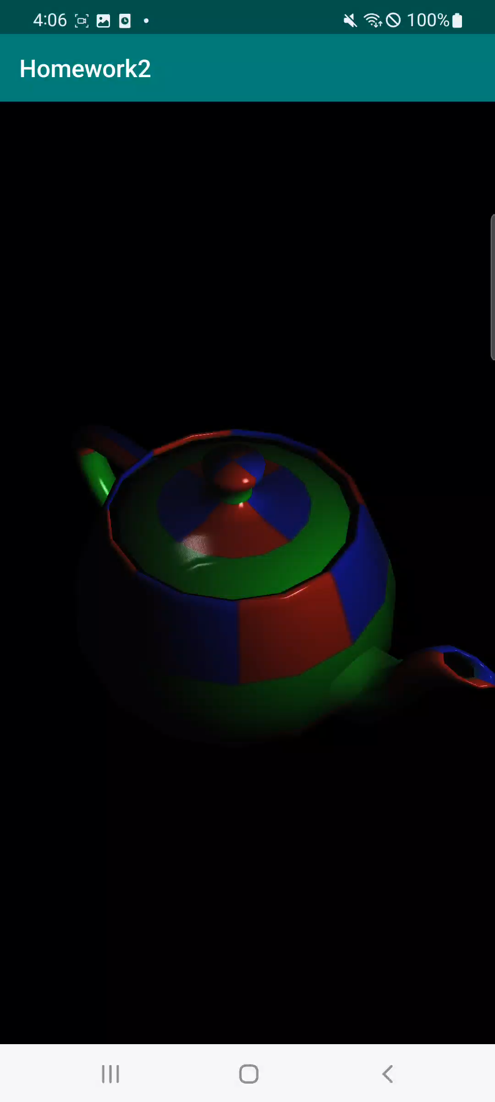

Problem 4
알파 블렌딩을 구현한다.
알파의 값은 해당 픽셀의 RGB 색상 값의 크기로 설정한다.
$α=\sqrt{R^{2}+G^{2}+B^{2}}$

Slide 11
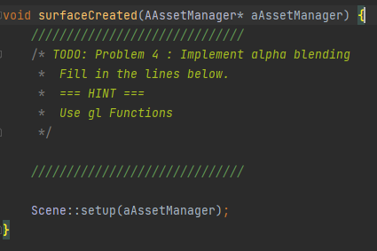
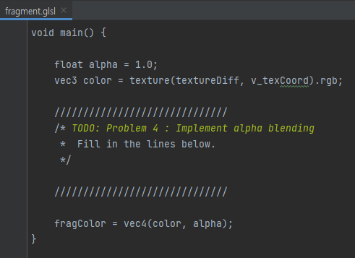

Problem 4
Enable alpha blending to make the teapot transparent.
app/src/main/cpp/main.cpp
Specify the blending function : $c=αc_{f}+\left(1−α\right)c_{p}$
Fill in some lines in the fragment shader.
app/src/main/assets/fragment.glsl

Slide 12
Submission
Deadline
May 17 (Wed) 14:00
Submission files ({student_id}_{name}.zip)
Vertex shader file (app/src/main/assets/vertex.glsl)
Fragment shader file (app/src/main/assets/fragment.glsl)
Scene class file (app/src/main/cpp/scene.cpp)
Main source file (app/src/main/cpp/main.cpp)
Submission to Blackboard
Contact
TA email: 2023.cg.ta@gmail.com

